Slide 1

Evaluating Low-Risk Aircraft Models for Commercial and Private Operations
Presented by: Lydia Mangoa
24th November 2024

Slide 2
Overview
Goal:
Identify low-risk aircraft models for commercial and private operations by analyzing historical aviation accident data.
Objectives:
Understand trends in aviation accidents.
Evaluate the impact of aircraft design (e.g., engine configurations) on safety.
Provide data-driven recommendations to guide fleet selection.

Slide 3
Business Understanding
Stakeholders:
Head of Aviation Division: Makes purchasing decisions.
Leadership Team: Focused on minimizing financial and operational risks.

Slide 4
Business Understanding cont…
Key Business Questions:
Which aircraft models have the lowest accident rates?
How does engine configuration affect safety and fatality rates?
What accident trends should inform aircraft selection?
Why This Matters: Reducing operational risks and improving safety enhances the company’s reputation and ensures financial sustainability.

Slide 5
Data Understanding
Data Source: The Kaggle Aviation Accident Database Synopses, a historical dataset with 88,889 records of aviation accidents. Key Variables Analyzed:
Aircraft Models: Accident frequency by model.
Number of Engines: Impact on safety and fatalities.
Weather Conditions: Influence on accident rates. Challenges: Addressing missing data and inconsistent reporting (e.g., unknown weather conditions).

Slide 6
Data Analysis
Visualization: Top 10 Aircraft Makes by Accident Count (Bar Chart)
Key Insight: High accident counts for some models (e.g., Cessna, Piper) may reflect widespread use rather than inherent risk.
Business Recommendation: Focus safety audits and maintenance efforts on these high-usage models

Slide 7
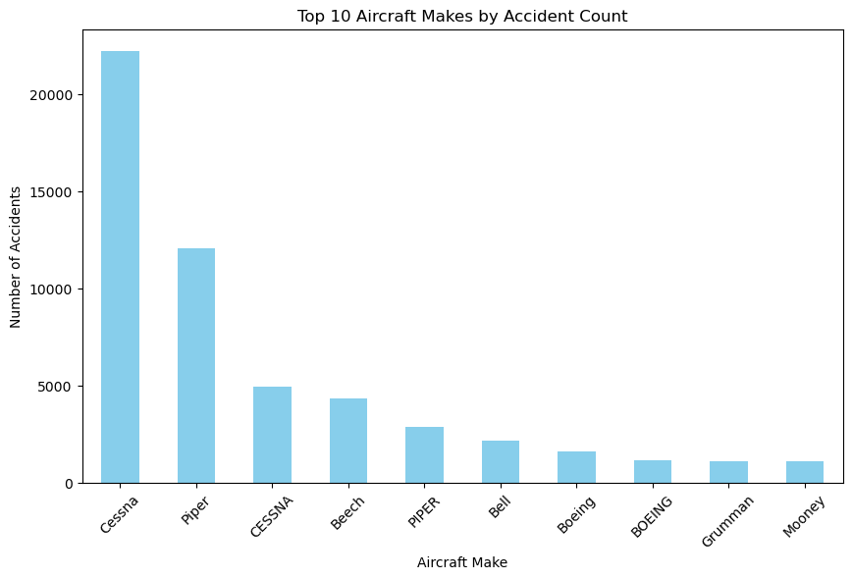

Slide 8
Data Analysis Cont…
Visualization: Yearly Trend in Aviation Accidents (Line Chart)
Key Insight: A declining trend in accidents since the 1980s, reflecting technological advancements and improved safety practices. Modern aircraft are safer due to enhanced navigation, automation, and design improvements.
Business Recommendation: Focus fleet acquisitions on newer models with advanced safety features.

Slide 9
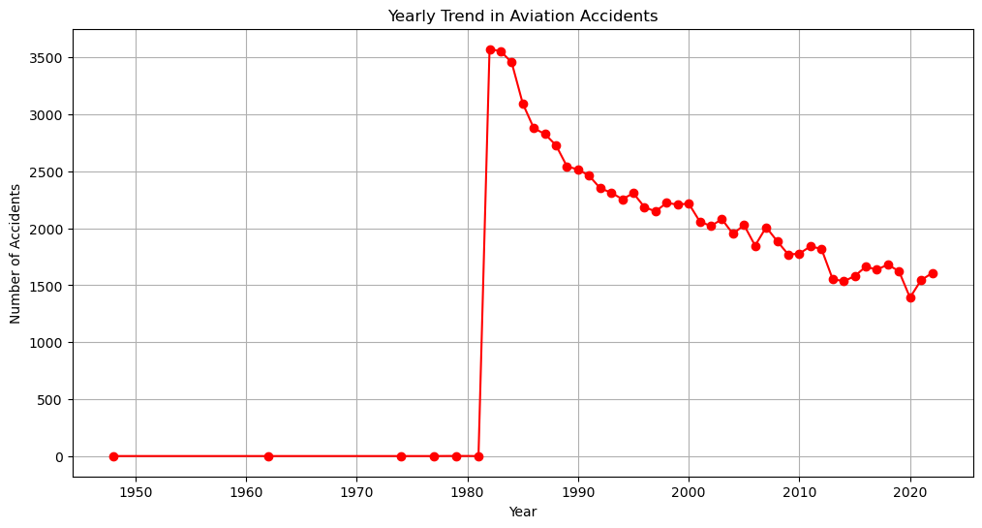

Slide 10
Data Analysis - Safety by Engine Configuration
Visualization: Fatality Rate by Number of Engines (Bar Chart)
Key Insight: Multi-engine aircraft have lower fatality rates than single-engine aircraft, emphasizing the safety of redundancy.
Business Recommendation: Prioritize multi-engine aircraft for high-stakes commercial operations.

Slide 11
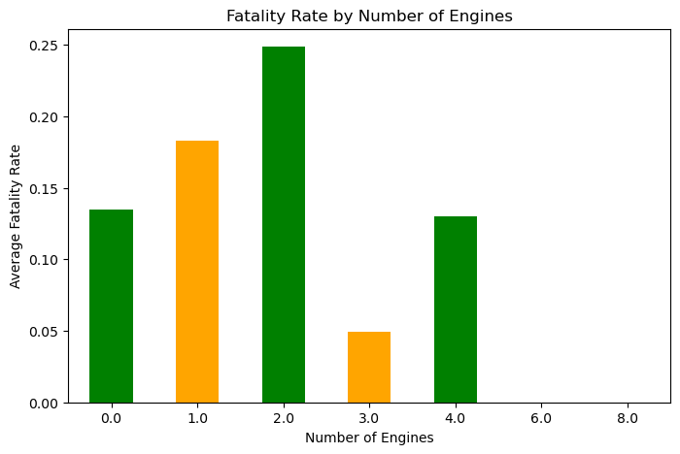

Slide 12
Recommendations
Focus on Proven Safe Models:
Select aircraft like modern iterations of Boeing and Airbus models with strong safety records.
Emphasize on Multi-Engine Aircraft:
Multi-engine redundancy enhances safety for high-stakes and commercial operations.
Invest in Technology:
Opt for aircraft with advanced weather detection and automation features.

Slide 13
Next Steps
Deep Dive into Top Models: Conduct safety and reliability assessments for frequently used aircraft models.
Pilot Program for Multi-Engine Aircraft: Test the operational and financial performance of multi-engine aircraft in select routes.
Strengthen Safety Culture: Enhance training programs and maintenance schedules for high-usage aircraft.
Address Data Gaps: Collaborate with aviation authorities to improve weather and accident reporting standards.

Slide 14
Thank You. Q&A
Name: Lydia Mangoa
LinkedIn profile: https://www.linkedin.com/in/lydia-mangoa-2b5b68a8?lipi=urn%3Ali%3Apage%3Ad_flagship3_profile_view_base_contact_details%3BsgMVvZ7QTASgptfjPpr2cw%3D%3D

